Slide 1
Team 10

Slide 2
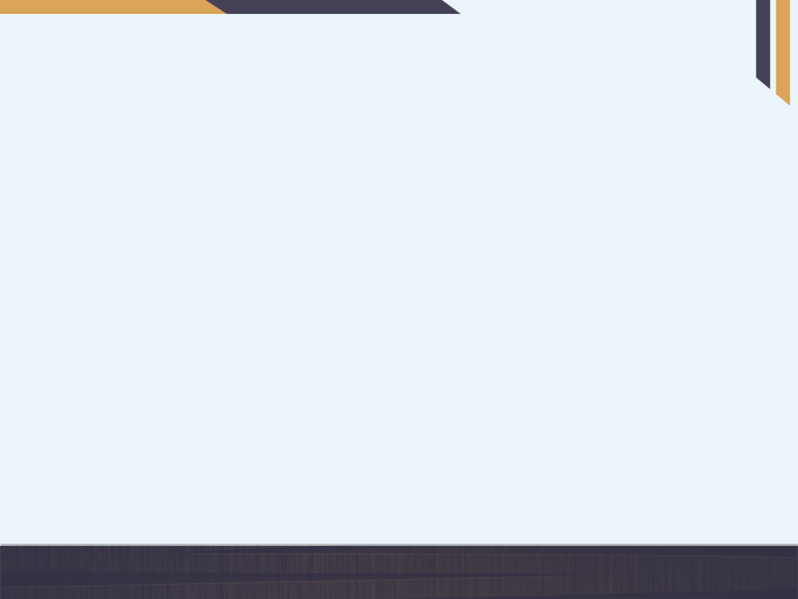
Preprocessing
In the preprocessing step, we first aligned the image using perspective transform, removed any unwanted background and mapped the four corners of the prescription to the screen.
We assumed that the biggest rectangle in the image is the prescription and finding that contour we mapped it to the screen.
After mapping it to the screen, we binarize the image using the OTSU’s Thresholding method.

Slide 3
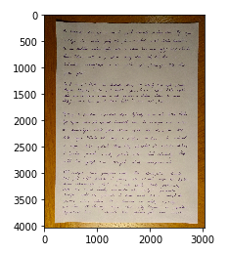
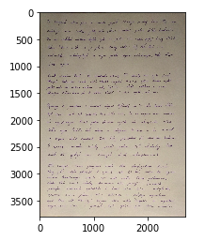
Preprocessing

Slide 4
Doctor’s information
The Doctor’s information is extracted from the prescription assuming that there is always a horizontal line separating the Doctor’s information and the handwritten text.
Then the inbuilt PyTesseract is used to read the Doctor’s information with their respective labels.
The following are the output details expected :- Doctor’s name, Designation, Address, Registration number, Phone number, Hospital’s name

Slide 5
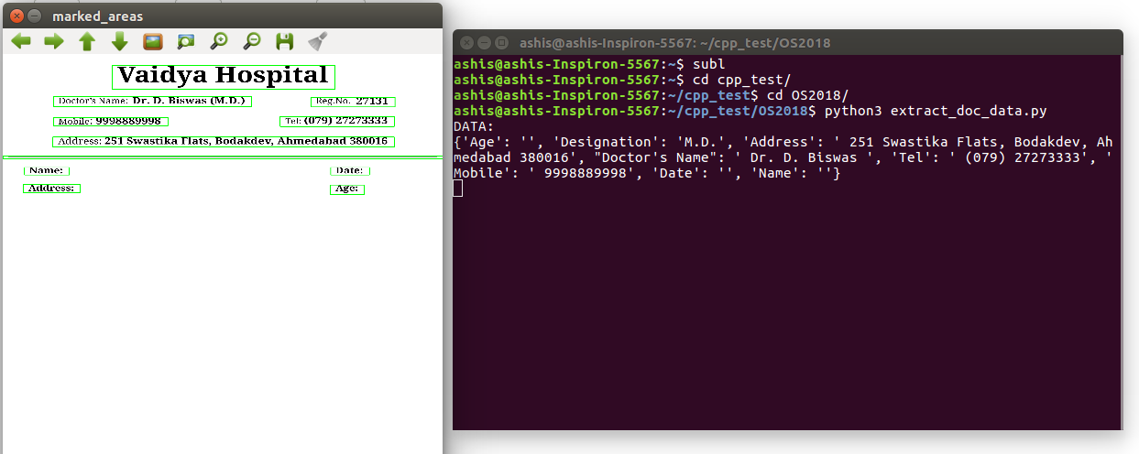
Doctor’s information

Slide 6
Block Detection
The blocks have been detected via the method of contour detection and connected components algorithm.
The image is dilated a number of times to facilitate the use of connected components method.
The thresholding is done in such a way that if two lines are situated less than a specified distance they would combine to form a block

Slide 7
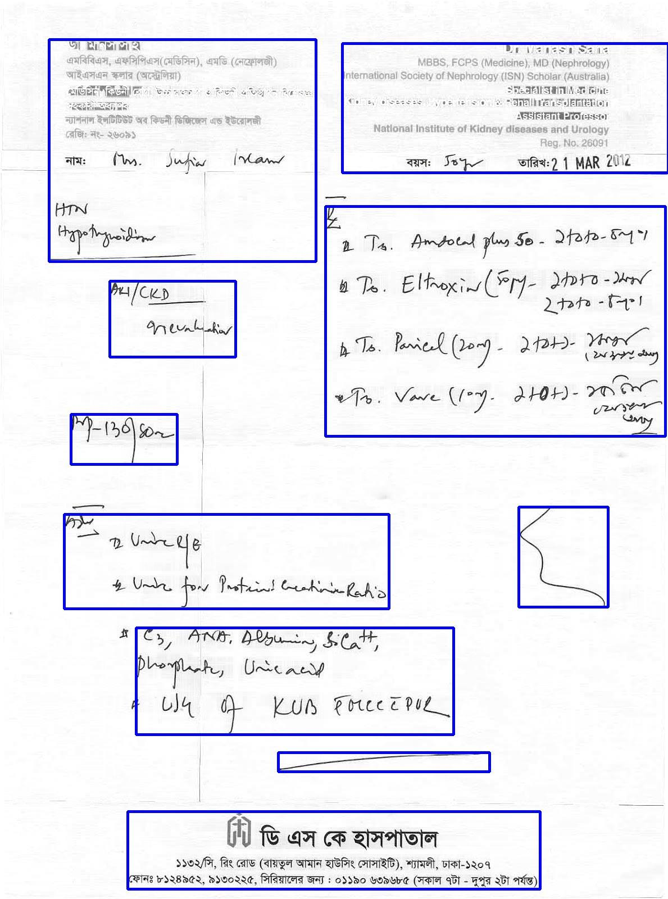
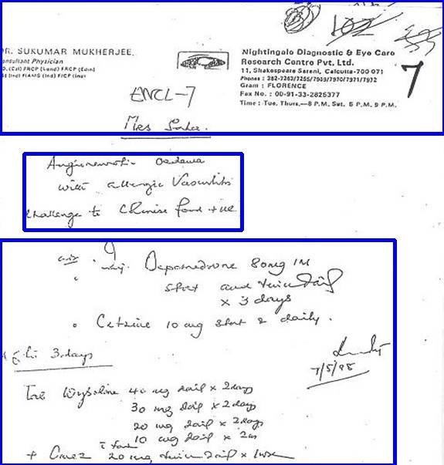
Block detection

Slide 8
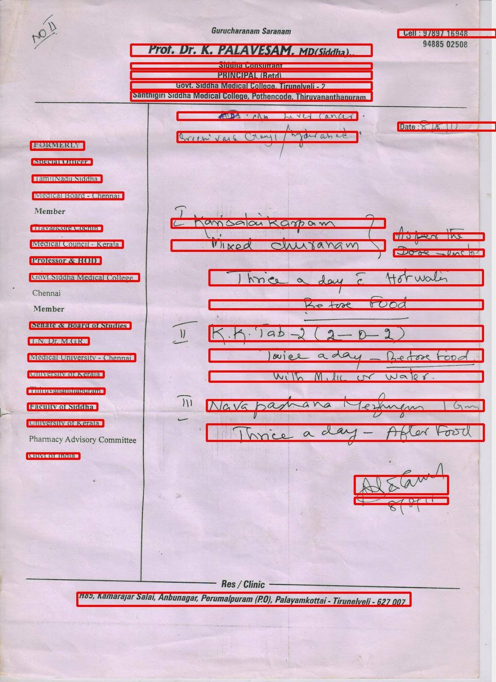
Line detection
The method of projection is used to differentiate between two lines.
After the image was binarized, the number of white pixels was calculated and based on a particular threshold, line was extracted from the given block.
The input of the line detection is the individual blocks which we extracted in the previous step.

Slide 9
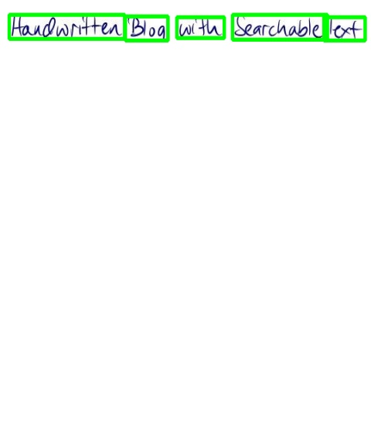
Word detection
The lines extracted in the previous step are the input of this step.
The lines extracted are binarized and sent to the word extraction algorithm.
The line is dilated and the connected components algorithm is applied on the same, forming contours around individual blocks of text

Slide 10
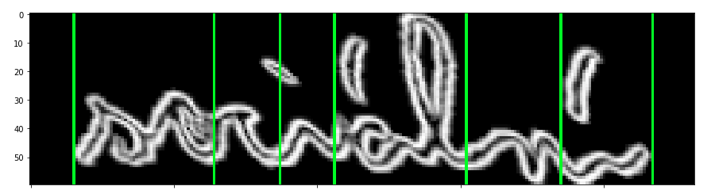
Character segmentation
We tried to segment the characters based on fixed barriers of 50 pixels but due to non uniformity in the handwriting the method did not turn out to be useful.
Characters are segmented based on RNN model, the model was trained from a training set.
The training set was small, so the model was underfitting and the results were not up to the mark.

Slide 11
Letter Prediction
Instead of using an API such as Microsoft Azure service, Google Vision etc, we tried making our own model, but due to the lack of proper data set present, the results were not up to the mark.

Slide 12
Spelling error correction
For spelling error correction, we have used the Peter Norwig algorithm.
For every word that we get in the Word detection, we have checked the words from three dictionary namely : Medicines Symptoms Tests
Every word is checked with respect to closest edit distance matching with it.

Slide 13
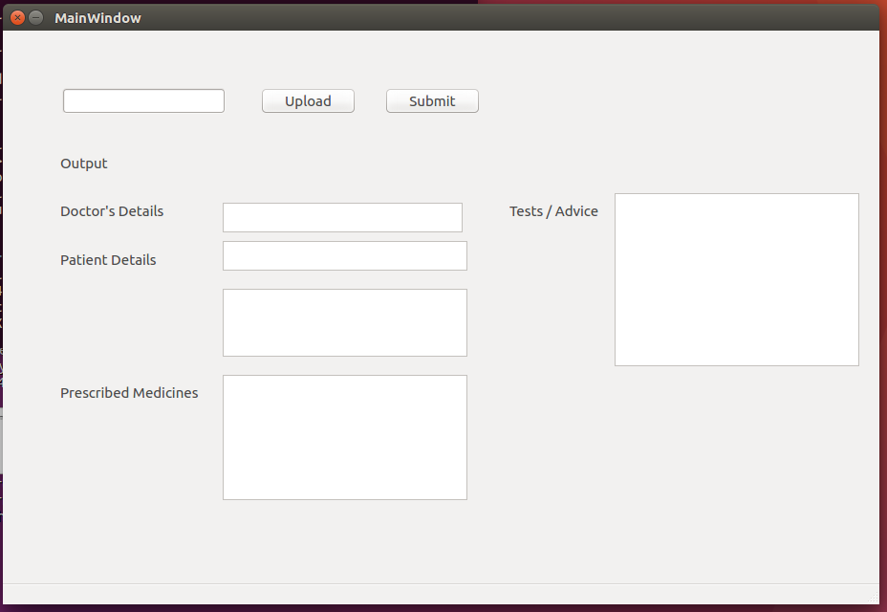
GUI

